Slide 1

Economics
Seventh Edition
Chapters
13, 14, 15 & 16
Monopoly,
Monopolistic Competition,
Oligopoly
and Pricing Strategy
Copyright © 2019, 2017, 2015 Pearson Education, Inc. All Rights Reserved.
Notes:
If this PowerPoint presentation contains mathematical equations, you may need to check that your computer has the following installed:
1) MathType Plugin
2) Math Player (free versions available)
3) NVDA Reader (free versions available)

Slide 2
Look for the answers to these questions:
Why do monopolies arise?
Why is MR < P for a monopolist?
How do monopolies choose their P and Q?
How do monopolies affect society’s well-being?
What can the government do about monopolies?
What is price discrimination?

Slide 3
Monopoly,
Monopolistic Competition,
Oligopoly
& Pricing Strategy

Slide 4
Part I:
MARKET DEFINITIONS

Slide 5
Introduction
Monopoly
A firm that is the sole seller of a product without close substitutes
Has market power
A monopoly is a price maker as it can set the price of the product that it sells
Arise due to barriers to entry
Other firms cannot enter the market to compete with it
Notes:
Most students already know that monopoly means the firm is the only seller of its product. But the definition here has another very important part: In order for the firm to be considered a monopoly, the product it sells must have no close substitutes available from other firms.

Slide 6
Oligopoly
Oligopoly
Only a few sellers in the market
Has Market Power
An oligopoly is a price maker as it can set the price of the product that it sells
Similar or identical products
An oligopoly’s decisions about P or Q affects other firms, causing them to react
The oligopoly will consider these reactions when making decisions

Slide 7
Measuring Market Concentration
Concentration ratio
The (3) 4 largest firms control at least 50% of output supplied
In general, the higher the concentration ratio, the less competition

Slide 8
Measuring Market Concentration
But for a certain level of concentration,
The higher the degree of rivalry amongst the firms, the lower the profits
The lower the degree of rivalry amongst the firms, the higher the profits
Game theory: the study of how people behave to make strategic situations

Slide 9
Concentration Ratios in Selected U.S. Industries
0
Industry | Concentration ratio
Video game consoles | 100%
Tennis balls | 100%
Credit cards | 99%
Batteries | 94%
Soft drinks | 94%
Web search engines | 92%
Breakfast cereal | 92%
Cigarettes | 89%
Greeting cards | 88%
Beer | 85%
Cell phone service | 82%
Autos | 79%
Notes:
9
Sources: U.S. Census Bureau (www.census.gov), Federal Trade Commission (www.ftc.gov), and various periodicals and microeconomics textbooks.

Slide 10
Ten Ways to Become a Monopoly
Monopoly resources
A single firm owns a key resource.
i.e.: DeBeers owns most of the world’s diamond mines
Government regulation
The government gives a single firm the exclusive right to produce the good.
i.e.: USPS, sewage, water,…

Slide 11
Ten Types of Monopoly
The production process
Natural monopoly: a firm can produce at lower cost than could several firms
e.g.: economies of scale
Electricity, Water
Cost
Example: 1000 homes need electricity.
ATC is lower if one firm services all 1000 homes than if two firms each service 500 homes.
ATC slopes downward due to huge FC and small MC
$80
$50
ATC
Q
500
1000
Notes:
The horizontal axis of the graph measures number of homes provided electricity. The vertical axis measures the average total cost of providing electricity per home.

Slide 12
Ten Types of Monopoly
Monopoly through competition
Walmart: A company follows market rules, but somehow does it better than their competitors
Monopoly through merger & acquisitions
CVS / Aetna, Airlines, Sprint/T-Mobile
Regional Monopolies
Network Externalities
Facebook, Google Search: the more the product is used, the greater its value
Notes:
The horizontal axis of the graph measures number of homes provided electricity. The vertical axis measures the average total cost of providing electricity per home.

Slide 13
If Monopolies are bad, Why Do They Exist?
Sometimes, even though they may hurt the consumers, monopolies and oligopolies can help some, or even the country such as in the context of:
Patents, Copyright Laws
National Defense
Competition in the International Setting

Slide 14
Perfect Monopolistic
Competition Competition Monopoly
or Oligopoly
# of sellers Many A few One
Free entry/exit Yes Yes No
Long-run π Zero Small Positive
Products sold Identical Partial Substitute No substitute
Market power None Yes Yes
Firm’s D curve Horizontal Downward- Downward-
sloping sloping
Notes:
Monopolistic competition
- Long-run profits for are zero because of free entry/exit.
- The market power: it sells a product that is at least somewhat different from products sold by other firms.
- The D curve is downward-sloping because the firm has a bit of market power and sells a unique variety.
A monopoly is the sole seller of a product with no close substitutes. In contrast, the monopolistic competitor sells a product with many close substitutes. As a result, demand for the monopolist’s product is less elastic than demand for the monopolistic competitor’s product.

Slide 15
Part II:
PRICING STRATEGIES

Slide 16
Capturing Value
Firms in competitive markets are price takers
But because firms with market power can choose price, quantity, they have more control over the choice of the product that they sell
Hence, they can capture value if they exploit their market power

Slide 17
Understanding the Monopolist’s MR
Unlike a firm operating in a competitive environment, a monopoly must decrease the price of the good to sell more goods
Hence, its marginal revenue, MR < P
Increasing Q has two effects on revenue:
Output effect: higher output raises revenue
Price effect: lower price reduces revenue
Increasing production is profitable only if output effect > price effect, which depends on the consumer price sensitivity
Notes:
Note that a competitive firm has the output effect but not the price effect: the competitive firm does not need to reduce its price in order to sell a larger quantity, so, for the competitive firm, MR = P.

Slide 18
Cost-Plus Pricing
Add a markup to average total cost to determine the sale price
Must account for price sensitivity or the price elasticity of demand of the consumer
Must account for changes in costs of production that arise

Slide 19
Block Pricing or Bulk Pricing
Ex: Costco
Declining price on larger quantities sold
Counters the lower marginal value that consumers’ have for additional units

Slide 20
Two-Part Tariffs
Ex: entrance fee and supplemental usage fee
Up-front fee for the right to purchase
Additional fee per unit purchased
Best when customers have relatively homogenous demand for product
Used at country clubs, health clubs, college football games

Slide 21
Price Discrimination
Price discrimination:
Firms can increase profits by charging higher prices to buyers that are willing to pay more
Firms sell the same good at different prices
Personalized pricing
Ex: negotiated sales to extract maximum amount each customer is willing to pay
“First degree” price discrimination
Possible only with small number of buyers
Notes:
Discrimination: treating people differently based on some characteristic, e.g. race or gender.

Slide 22
Using Information About Individuals
Menu pricing
“Second degree” price discrimination
Consumers select preferred package
Companies often use different versions of their product – deluxe, basic, etc.
Group pricing
Ex: theaters, airlines…
“Third degree” price discrimination
Firms divide customers in groups based on characteristics related to willingness to pay (WTP) (e.g.: age, students,…)
The group with the more inelastic demand pays a higher price

Slide 23
Using Information About Individuals
Coupons and Rebates
Users of coupons and rebates likely have a higher price sensitive
Firms target different customers groups in different market by offering coupons and rebates through different media
The hopes of firms is that the users who are new customers may continue to purchase the product
Couponing detrimentally affects profits when coupons and rebates are anticipated

Slide 24
Bundling or Bundle Pricing and Other Concerns
Bundling may yield a higher price than if each component is sold separately
season tickets
three course meals at restaurants
Multi-period pricing
low initial price can “lock-in” customers
Strategic considerations
low price may be barrier to entry

Slide 25
Penetration or Introductory Pricing
Low price charged by companies until their product is well known by the customer
The price of the good or the service then increases in the future
Used to familiarize the customer with a new product
This strategy is used to penetrate a new market

Slide 26
Part III:
MARKETING
ADVERTIZING

Slide 27
Advertising
Incentive to advertise
When firms sell differentiated products and charge prices above marginal cost
Advertise to attract more buyers
Advertising expenditure
Highly differentiated goods: 10-20% of revenue
Industrial products: Little advertising
Homogenous products: No advertising

Slide 28
Advertising
The more differentiated the products
The more firms advertise
Economists disagree about the social value of advertising:
Wasting resources?
Valuable purpose?

Slide 29
The Critique of Advertising
Firms advertise in an attempt to manipulate consumer’s tastes
A psychological advertising creates a desire rather than informs the customer about a good
Advertising impedes competition, but it
Increases the perception of differentiation by fostering brand loyalty; higher markups. It makes buyers less concerned with price differences among similar goods
Might provide useful information to buyers

Slide 30
The Defense of Advertising
The defense of advertising
It provides useful information to buyers
Informed buyers can more easily find and exploit price differences
Advertising promotes competition and reduces market power
Notes:
The study mentioned here was by economist Lee Benham, published in the Journal of Law and Economics in 1972. The textbook has a case study that discusses this research in more detail.

Slide 31
Public Policy Toward Monopolies
Increasing competition with antitrust laws and regulations
Sherman Antitrust Act, 1890
Prevent mergers
Break up companies
Prevent companies from coordinating their activities to make markets more competitive

Slide 32
Public Policy Toward Monopolies
Do nothing
Some economists argue that it is better for the government to do nothing as the determination of monopoly impact and the solution requires judgments about politics as well as economics, which is difficult
Furthermore, there are advantage to the home country to have monopolies operating internationally

Slide 33
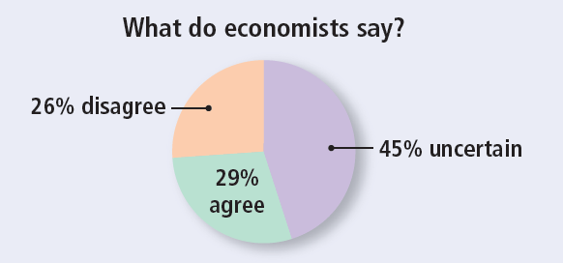
ASK THE EXPERTS
Airline Mergers
“If regulators had not approved mergers in the past decade between major networked airlines, travelers would be better off today.”
Notes:
This ‘Ask the experts’ feature provides the opportunity for class discussion.
After showing the statement, you can ask your students to choose one of the options: agree, disagree, or uncertain. You can collect their answers in a variety of ways: show of hands, ballot, clicker system, etc. If time permits, you can allow students to group and discuss some of the reasons they chose their answer.
Ask the students to share with the class their reasons. Their answers will vary.

Slide 34
Part IV:
Game Theory

Slide 35
Oligopoly Games
What Is a Game?
Game theory studies strategic behavior, taking into account the expected behavior of others and the mutual interdependence to derive the optimal solution.
All games have four common features:
Players
Rules
Strategies
Payoffs
Outcome
Notes:
Game Theory
Game theory is an entirely different approach to modeling a firm’s output and price decisions. It allows for the expected actions of all other firms in the market to be explicitly considered in the firm’s decision-making process. Game theory is a big step for the student and needs a significant amount of time to develop. This chapter is designed to be flexible and provide you with many options on just how far to go.
1.You might want to introduce only the prisoner’s dilemma game. Pages 344–345 enable you to do that.
2.You might want to spend serious time applying the prisoner’s dilemma to a cartel game. Pages 346-350 enable you to do that.
3.You might want to extend the range of examples and apply the prisoner’s dilemma to a real-world research and development game. Page 351 enables you to do that.
4. You might want to extend to other games such as the game of chicken. Page 351 enables you to do that.
4.Finally, you might want to introduce repeated and sequential games and some of their applications and implications. Pages 352–355 enable you to do that.
6.Each of the steps laid out above is optional, but cumulative. You can stop at any point, but shouldn’t try to skip one step with the exception that you can teach the R&D game based on the general introduction to the prisoner’s dilemma without teaching the longer and more complex cartel game.

Slide 36
Oligopoly Games
The Prisoners’ Dilemma
In the prisoners’ dilemma game, two prisoners, Art and Bob, have been caught committing a crime.
Rules
The rules describe the setting of the game, the actions the players may take, and the consequences of those actions.
Each is held in a separate cell and cannot communicate with the other.
Notes:
The prisoners’ dilemma
Take things a step at a time and begin by playing the prisoner’s dilemma game. A good Web version of the game can be found on a site operated by a group called Serendip at Bryn Mawr College in Pennsylvania. The URL (also on your Economics Place Web site) is http://serendip.brynmawr.edu/playground/pd.html. If you can use the Web in your classroom, open two browsers and go to this site twice. Get two teams trying to beat Serendip.

Slide 37
Oligopoly Games
Each is told that both are suspected of committing a serious crime.
If one of them confesses, he will get a 1-year sentence for cooperating while his accomplice will get a harsh 10-year sentence for the crime.
If both confess, they each receives a 3-year sentence.
If neither confesses, each receives a 2-year sentence only.

Slide 38
Oligopoly Games
Strategies
Strategies are all the possible actions of each player.
Art and Bob each have two possible actions:
Confess and cooperate.
Deny and do not cooperate.

Slide 39
Oligopoly Games
Payoffs
Each prisoner can work out what happens to him in each of the four possible outcomes.
We put these outcomes in a payoff matrix.
A payoff matrix is a table that shows the payoffs for every possible action by each player for every possible action by the other player.

Slide 40
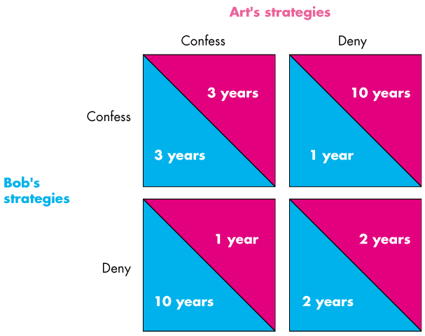
Oligopoly Games
Notes:
Be sure the students know how to read the payoff matrix.
Explain that Art’s payoff from each combination of actions is shown in the top of each payoff box, and Bob’s is shown as the bottom of each payoff box.
Note that there are four possible outcomes: Bob and Art both confess (top left box), both Bob and Art deny (bottom right box), Bob confesses but Art does not (top right box), and Art confesses but Bob does not (bottom left box).

Slide 41
Oligopoly Games
Outcome
A player will make a rational choice and choose the action that is best for him, given any action taken by the other player.
Finding the Nash Equilibrium
If both players are rational and choose their actions in this way, the outcome is an equilibrium called a Nash equilibrium.

Slide 42
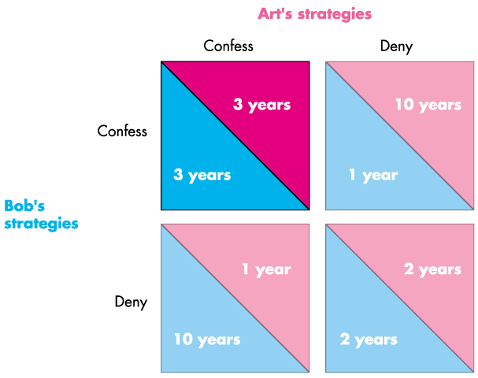
Oligopoly Games
Equilibrium
Notes:
Explain that we’re first going to look at Bob’s thought experiment.
He first asks: suppose that Art confesses. What should I do?
The answer is confess and get 3 years. If I deny, I get 10 years.

Slide 43
Oligopoly Games
The Dilemma
The dilemma arises as each prisoner contemplates the consequences of his decision and puts himself in the place of his accomplice.
Each knows that it would be best if both denied.
But each also knows that if he denies it is in the best interest of the other to confess.
The dilemma leads to the equilibrium of the game.

Slide 44
Oligopoly Games
A Bad Outcome
For the prisoners, the equilibrium of the game is not the best outcome.
If neither confesses, each gets a 2-year sentence.
Can this better outcome be achieved?
No, it can’t because each prisoner can figure out that there is a best strategy for each of them.
Each knows that it is not in his best interest to deny.

Slide 45
Repeated Games and Sequential Games
A Repeated Game
If a game is played repeatedly, it is possible for players to successfully collude and make a monopoly profit.
If the players take turns and move sequentially, many outcomes are possible.
Also, additional punishment strategies enable the firms to comply and achieve a cooperative equilibrium, in which the firms make and share the monopoly profit.
Notes:
The repeated prisoners’ dilemma and punishment
The interesting fact about this extension of the prisoners’ dilemma is that punishment strategies can support a cooperative equilibrium, lead to maximum (monopoly) profit, and an inefficient allocation of resources.

Slide 46
Repeated Games and Sequential Games
Tit-for-tat strategy or punishment strategy.
A tit-for-tat strategy is one in which one player cooperates this period if the other player cooperated in the previous period but cheats in the current period if the other player cheated in the previous period.
Trigger strategy: a more severe punishment.
A trigger strategy is one in which a player cooperates if the other player cooperates but plays the Nash equilibrium strategy forever thereafter if the other player cheats.

Slide 47
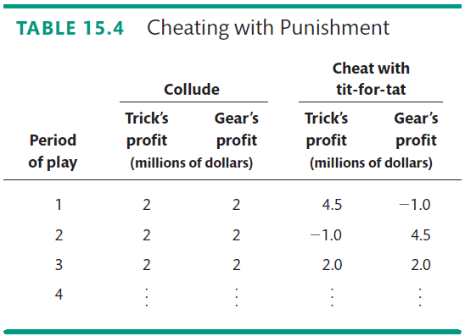
Repeated Games and Sequential Games
A tit-for-tat strategy can sometimes be sufficient to produce a cooperative equilibrium in a repeated game.

Slide 48
Repeated Games and Sequential Games
Games and Price Wars
Price wars might result from a tit-for-tat strategy where there is uncertainty about changes in demand.
A fall in demand might lower the price and bring forth a round of tit-for-tat punishment.

Slide 49
Repeated Games and Sequential Games
A Sequential Entry Game in a Contestable Market
In a contestable market: a market in which firms can enter and leave so that there is competition from potential entrants; firms thus play a sequential game.
Notes:
Entry game
The textbook uses the simplest possible example to illustrate the sequential entry game in a contestable market. It doesn’t explicitly explain the backward induction method of solving such a game, but it implicitly uses that method. You might want to be explicit.

Slide 50
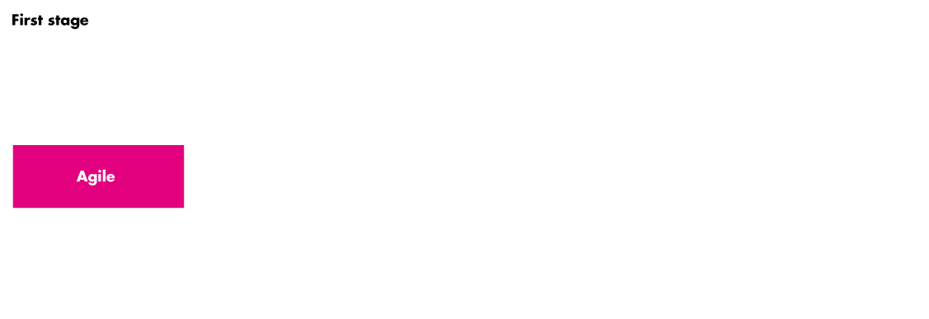

Repeated Games and Sequential Games
The game tree for a sequential entry game in a contestable market.

Slide 51
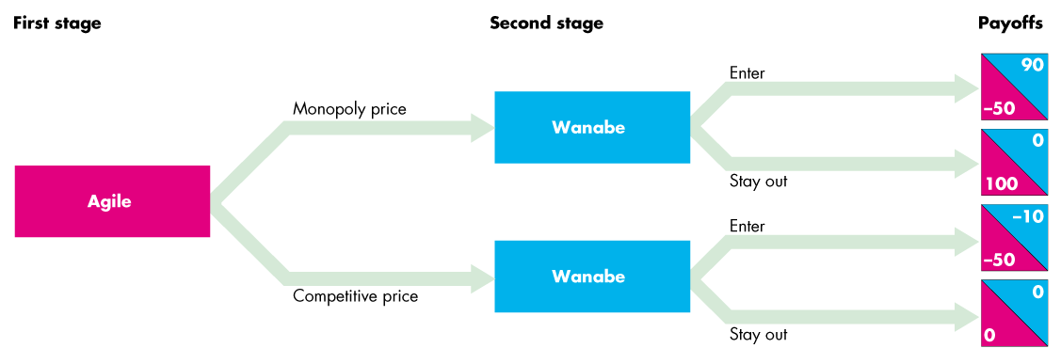
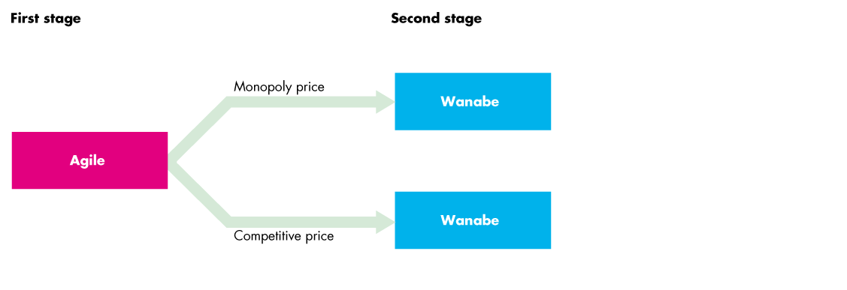

Slide 52
Repeated Games and Sequential Games
In the first stage, Agile decides whether to set the monopoly or the competitive price.

Slide 53
Repeated Games and Sequential Games
In the second stage, Wanabe decides whether to enter or stay out.
Wannabe’s payoffs (blue) and Agile’s (red)

Slide 54
Repeated Games and Sequential Games
The equilibrium is Agile sets a competitive price and makes zero economic profit to keep Wanabe out.

Slide 55
Summary
A monopoly is a firm that is the sole seller in its market.
A monopoly arises when a single firm owns a key resource, when the government gives a firm the exclusive right to produce a good, or when a single firm can supply the entire market at a lower cost than many firms could.
Faces a downward-sloping demand curve for its product.

Slide 56
Summary
Monopoly increases production by 1 unit
Causes the price of its good to fall, which reduces the amount of revenue earned on all units produced.
Marginal revenue is always below the price
A monopoly firm maximizes profit by producing the quantity at which marginal revenue equals marginal cost.
Sets the price at which that quantity is demanded. P > MR, so P > MC

Slide 57
Summary
A monopolist’s profit-maximizing level of output is below the level that maximizes the sum of consumer and producer surplus.
Causes deadweight losses
A monopolist can often increase profits by charging different prices for the same good based on a buyer’s willingness to pay.
Price discrimination can raise economic welfare
Perfect price discrimination, the deadweight loss of monopoly is completely eliminated

Slide 58
Summary
Policymakers can respond to the inefficiency of monopoly behavior in four ways
Use antitrust laws to try to make the industry more competitive
Regulate the prices that the monopoly charges
Turn the monopolist into a government-run enterprise
Can do nothing at all

Slide 59
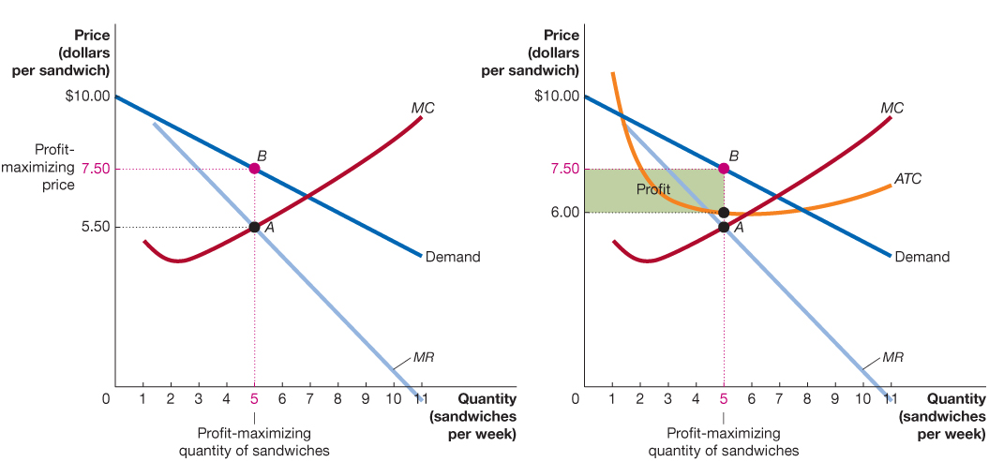
Determination of Monopoly Price & Quantity Maximizing Value
Notes:
The horizontal axis of the graph measures number of homes provided electricity. The vertical axis measures the average total cost of providing electricity per home.

